Slide 1
osce
Hematology
DR.HASSANALI VAHEDIAN ARDAKANI

Slide 2
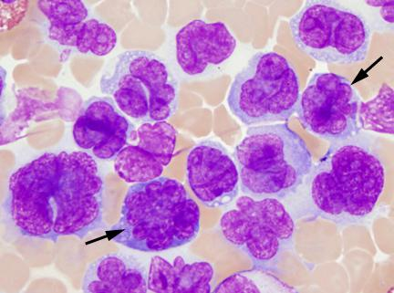
Leukemia cells feather edge

Slide 3
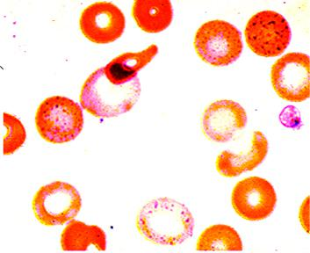
Basophilic stiplling

Slide 4
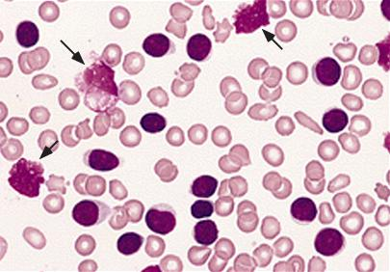
B cell chronic lymphocytic leukemia

Slide 5
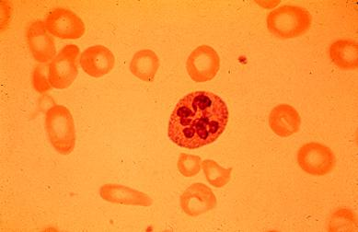
Megaloblastic blood picture

Slide 6
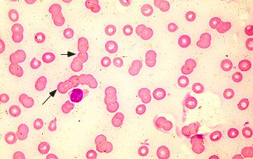
Rouleaux formation

Slide 7
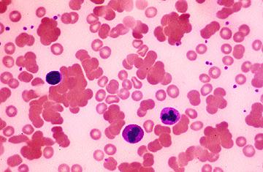
Cold agglutin

Slide 8
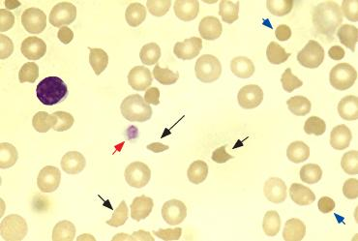
Microangiopathic smear

Slide 9
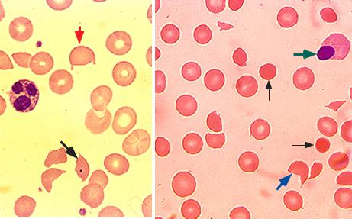
Helmet cells

Slide 10
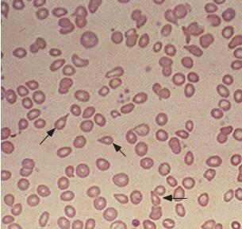
Teardrop cells

Slide 11
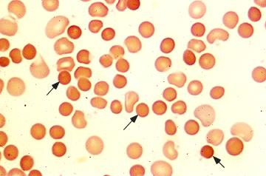
Spherocytes

Slide 12
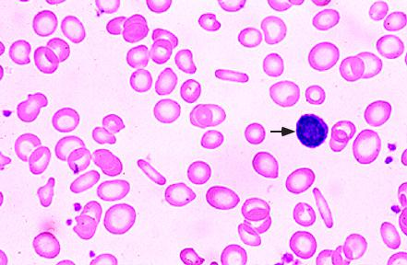
Microcytic hypochromic red cells

Slide 13
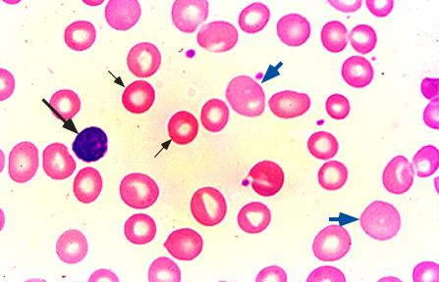
Polychromatophilia

Slide 14
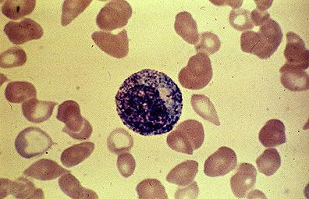
Normal human promyelocyte

Slide 15
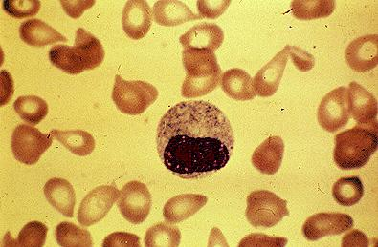
Normal human metamyelocyte

Slide 16
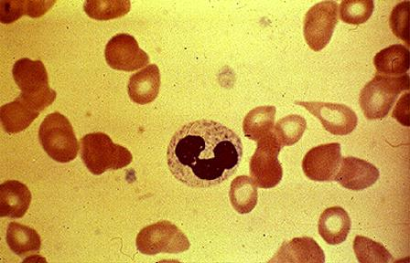
Normal human band form

Slide 17
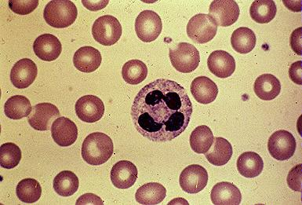
Normal human PMN

Slide 18
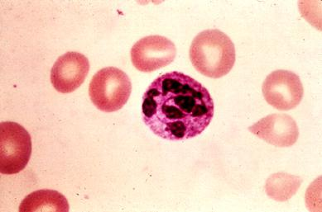
Hypersegmented neutrophil

Slide 19
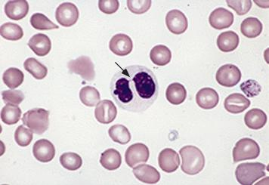
Pelger-Huet anomaly

Slide 20
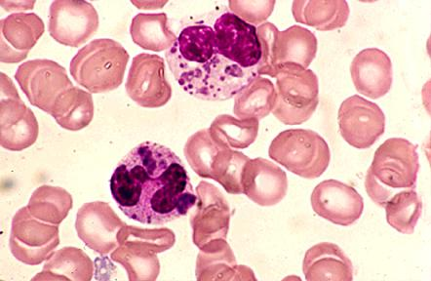
Chediak-Higashi syndrome

Slide 21
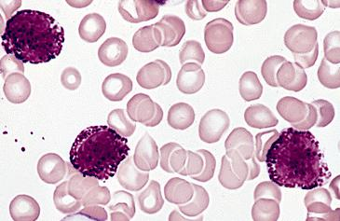
Basophils

Slide 22
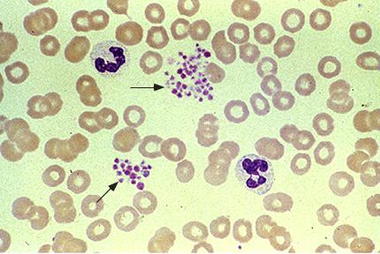
Platelet clumping in EDTA

Slide 23
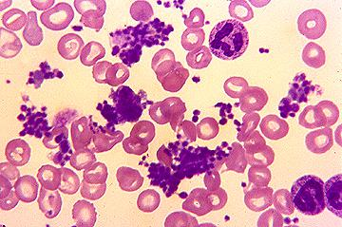
Essential thrombocythemia

Slide 24
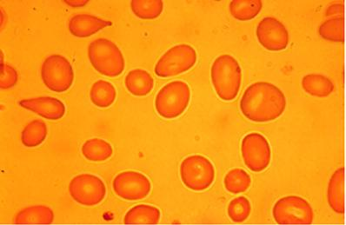
Macroovalocytosis

Slide 25
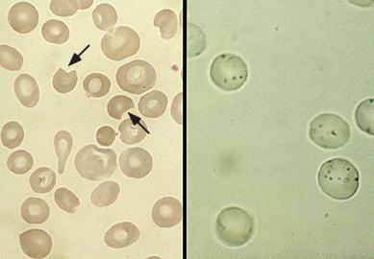
bite-like deformity Heinz body hemolytic anemia

Slide 26
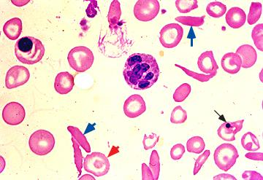
Sickle cell anemia

Slide 27
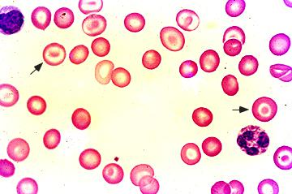
Target cell

Slide 28
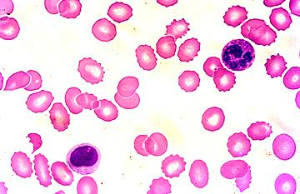
Echinocytes

Slide 29
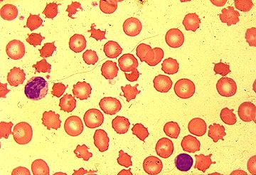
Acanthocytes

Slide 30
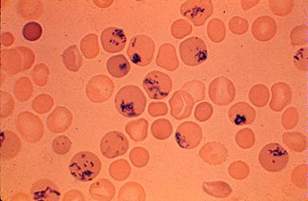
Reticulocytosis in peripheral blood

Slide 31
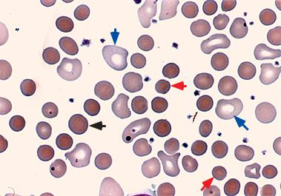
Peripheral blood smear in autoimmune hemolytic anemia (AIHA)

Slide 32
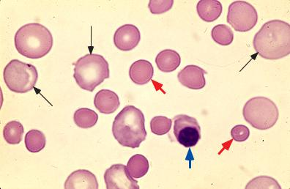
Autoimmune hemolytic anemia

Slide 33
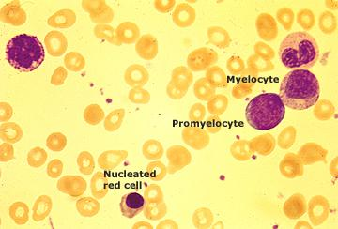
Leukoerythroblastic smear

Slide 34
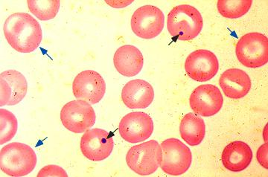
Howell-Jolly bodies

Slide 35
Basophilic stippling

Slide 36
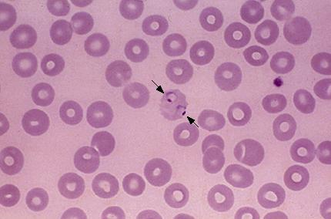
Malaria

Slide 37
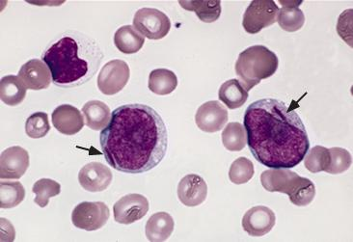
Myeloblasts with Auer rod

Slide 38
B cell chronic lymphocytic leukemia

Slide 39
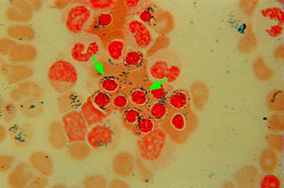
Ringed sideroblasts

Slide 40
Rouleaux formation

Slide 41
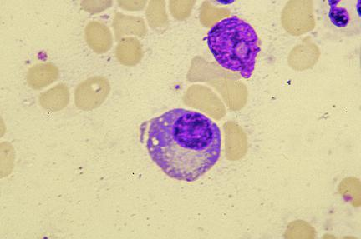
Plasma cell

Slide 42
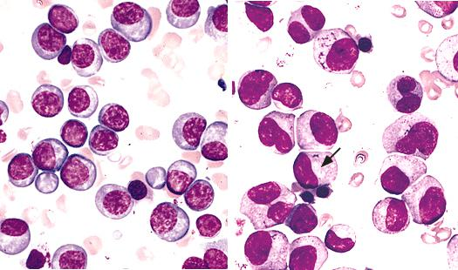
Multiple myeloma

Slide 43
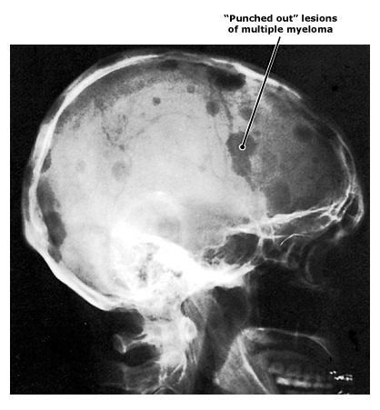
Multiple myeloma lytic lesions

Slide 44
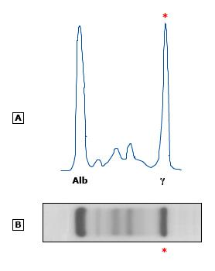
Monoclonal pattern SPEP

Slide 45
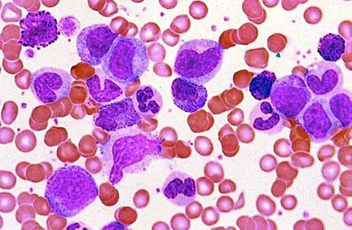
CML blood smear

Slide 46
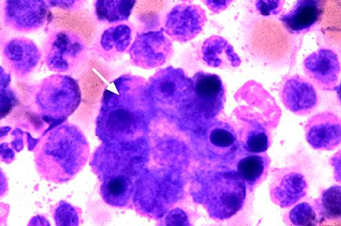
Clump of tumor cells in the bone marrow

Slide 47
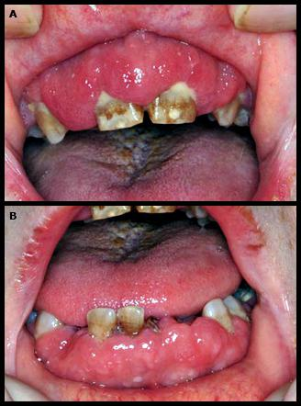
Gingival infiltration in acute monoblastic leukemia

Slide 48
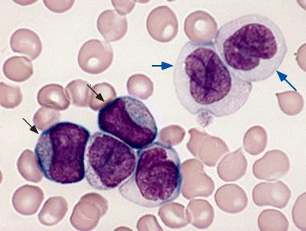
Acute myelomonocytic leukemia (M4)

Slide 49
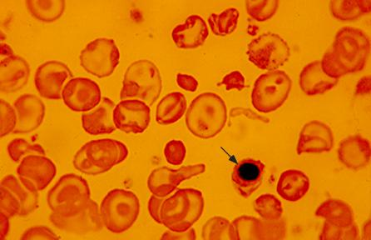
Beta thalassemia intermedia

Slide 50
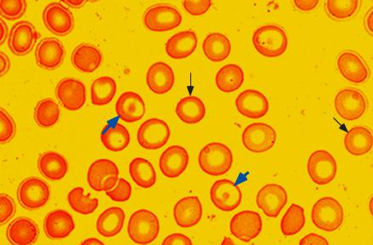
Beta thalassemia trait

Slide 51
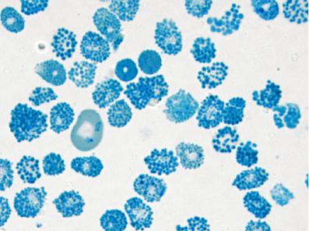
Hgb H inclusions golf ball-like

Slide 52
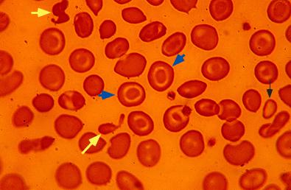
Hemoglobin H disease

Slide 53
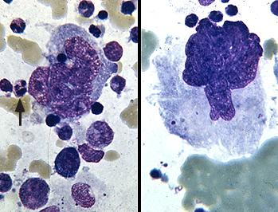
Megakaryocytes

Slide 54
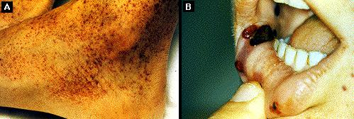
Petechiae in ITP

Slide 55

Petechiae in Henoch-Sch?nlein purpura

Slide 56

Giant platelets

Slide 57

Bone marrow in aplastic anemia

Slide 58

Myelodysplastic syndrome with abnormal megakaryocytic maturation

Slide 59

Acute lymphoblastic leukemia

Slide 60

Gaucher cells

Slide 61

Niemann Pick Cells

Slide 62

Megaloblastic erythropoiesis

Slide 63

Lymphoblasts (FAB L2)

Slide 64

Acute lymphoblastic leukemia (FAB L3)

Slide 65

Acute promyelocytic leukemia (M3)

Slide 66

Acute promyelocytic leukemia (M3V)

